Slide 1
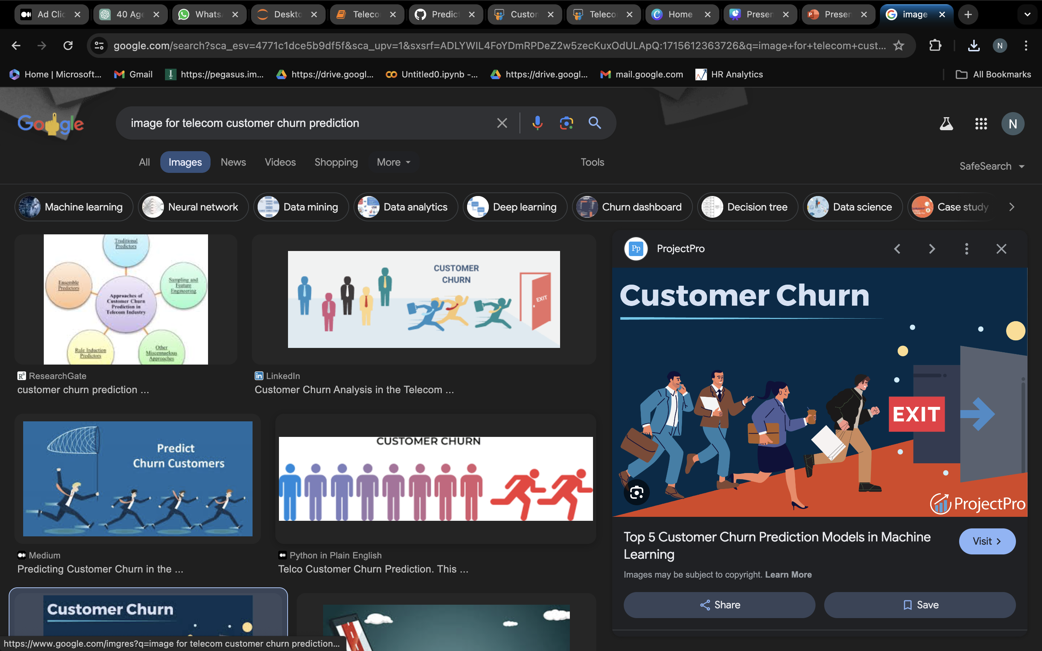

Telecom Customer Churn Prediction
Classification by Machine Learning model
Presented by: Nanditha J K

Slide 2
INTRODUCTION:
Churn Prediction is one of the most popular Big Data use cases in business. It consists of detecting customers who are likely to cancel subscription to a Service.
Churn is a problem for telecom companies because it is more expensive to acquire a new customer than to keep your existing one from leaving.
This project aims to develop a machine learning model in Python for predicting telecom customer churn, utilizing a dataset encompassing customer attributes and churn indicators.
By analyzing factors such as contract type, service usage, and customer demographics, the model seeks to forecast churn behavior and aid in retention strategies.

Slide 3
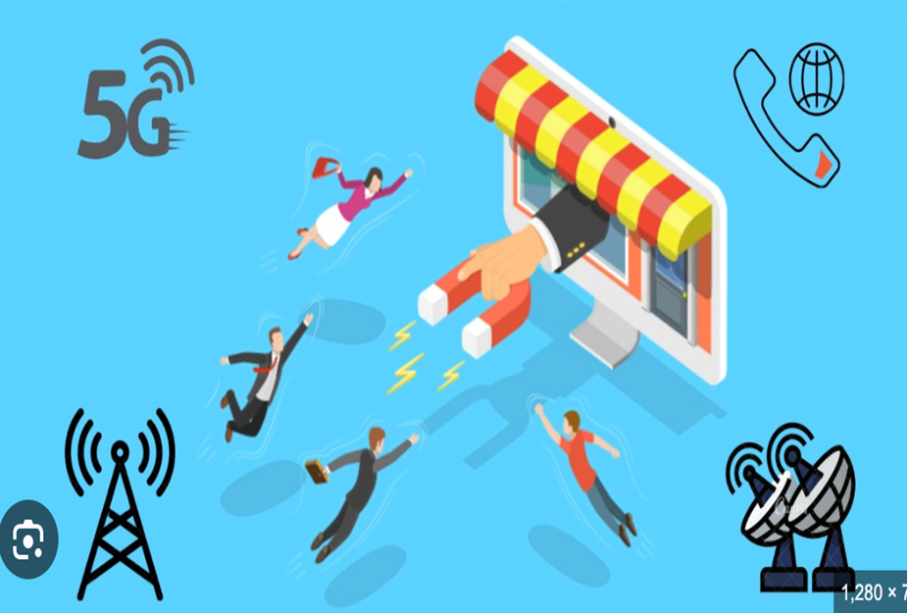
OBJECTIVE:
1. To predict customer churn.
2. Highlighting the main variables/factors influencing customer churn.
3. Use various ML algorithm to build predictive models, evaluate the accuracy and performance of these models.
4. Finding out the best model for our business case and providing executive summary.

Slide 4

Overview
The dataset comprises 7043 rows and 35 columns, containing various customer attributes and churn-related information. The dataset is taken from kaggle.
CustomerID: Unique identifier for each customer.
Count: Counter for each row.
Country: Country where the customer resides.
State: State where the customer resides.
City: City where the customer resides.
Zip_Code: Postal code of the customer's location.
Lat_long: Latitude and longitude coordinates of the customer's location.
Latitude: Latitude coordinate of the customer's location.
Longitude: Longitude coordinate of the customer's location.
Gender: Gender of the customer.
Senior_citizen: Indicator if the customer is a senior citizen (1) or not (0).
Partner: Whether the customer has a partner (Yes/No).
Dependents: Whether the customer has dependents (Yes/No).
Tenure_Months: Number of months the customer has been with the telecom company.
Phone_Service: Whether the customer has phone service (Yes/No).
Multiple_Lines: Whether the customer has multiple lines (Yes/No).
Internet_Service: Type of internet service subscribed by the customer.

Slide 5
18. Online_Security: Whether the customer has online security service (Yes/No).
19. Online_Backup: Whether the customer has online backup service (Yes/No).
20. Device_Protection: Whether the customer has device protection service (Yes/No).
21. Tech_Support: Whether the customer has technical support service (Yes/No).
22. Streaming_TV: Whether the customer has streaming TV service (Yes/No).
23. Streaming_Movies: Whether the customer has streaming movies service (Yes/No).
24. Contract: Type of contract subscribed by the customer (e.g., month-to-month, one year, two years).
25. Paperless_Billing: Whether the customer has opted for paperless billing (Yes/No).
26. Payment_Method: Payment method used by the customer.
27. Monthly_Charges: Monthly charges incurred by the customer.
28. Total_Charges: Total charges incurred by the customer.
29. Admin_Tickets: Number of administrative tickets raised by the customer.
30. Tech_tickets: Number of technical tickets raised by the customer.
31. Churn_Label: Label indicating churn status (Yes/No).
32. Churn: Indicator of churn (1 for churn, 0 for non-churn).
33. Churn_Score: Churn score assigned to the customer.
34. CLTV: Customer lifetime value.
35. Churn_Reason: Reason for churn (if applicable).

Slide 6

Exploratory Data Analysis (EDA)
Data Preprocessing and Cleaning:
Investigate missing values, outliers, inconsistencies and duplicates in the ad click dataset.Explore data distribution and correlations to identify patterns and potential biases.
Feature Engineering and Selection:
Extract relevant features such as time-related variables
Exploratory Data Visualization:
Use interactive visualizations to explore relationships between features and target variables, aiding in model interpretation and validation.

Slide 7
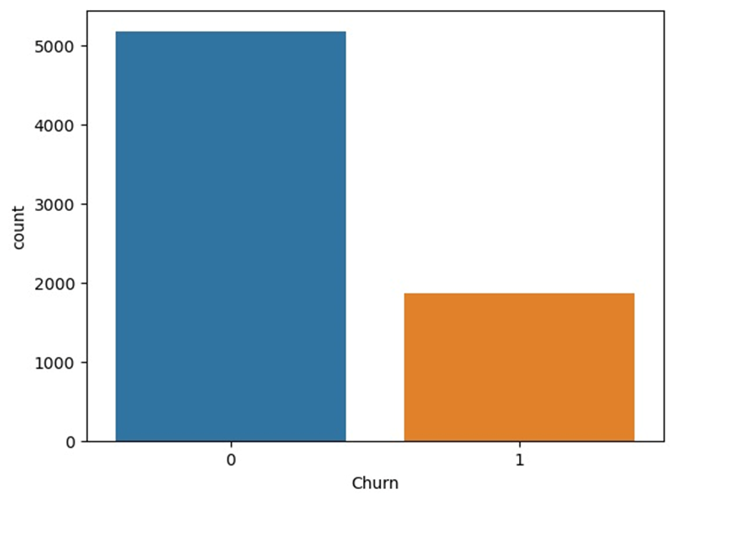
Target variable:
Distribution of Churn Rate in the dataset
0 = Non churned
1 = Churned

Slide 8
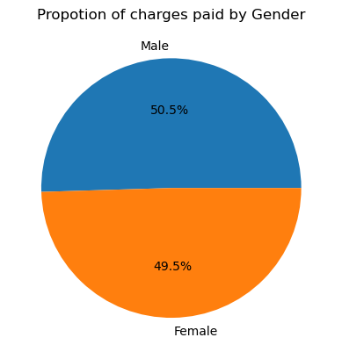
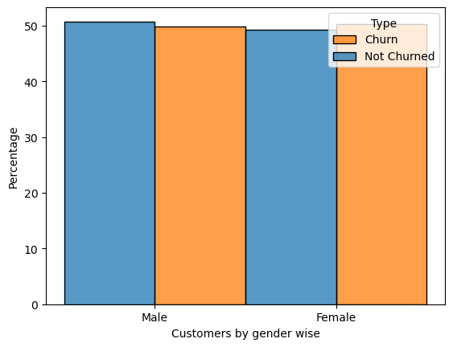
Proportion of charges paid by Gender
Customers by Gender wise
In the churn dataset, males account for approximately 50.48% of the charges paid, while females account for about 49.52%, suggesting a nearly equal distribution of charges paid between genders.

Slide 9
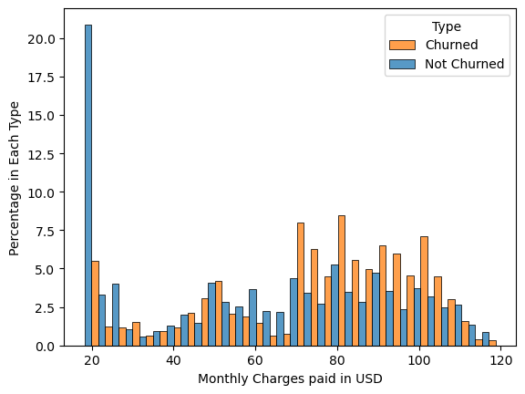
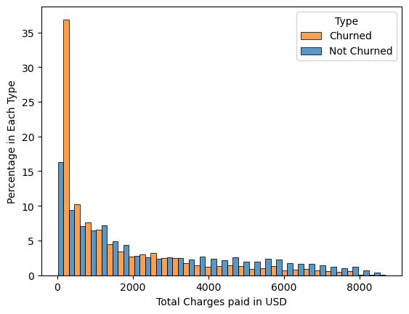
Monthly charges paid in USD
Total charges paid in USD
Highest total charges and monthly charges of customers who are not churned the company are 8672𝑈𝑆𝐷 𝑎𝑛𝑑 118.350000 USD respectively .
Highest total charges and monthly charges of customers who are churned the company are 8684.000000𝑈𝑆𝐷 𝑎𝑛𝑑 118.350000 USD respectively
By observing the summary, both customers who churn and non-churn are paying approximately same amount of charges.

Slide 10
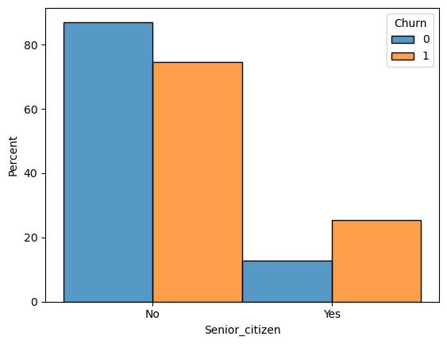
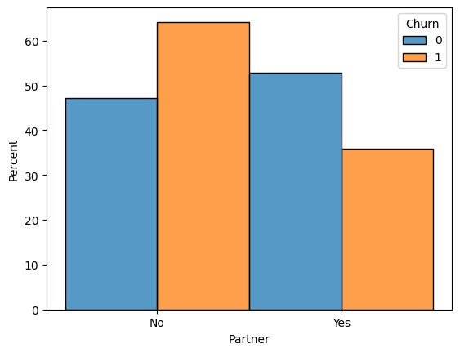
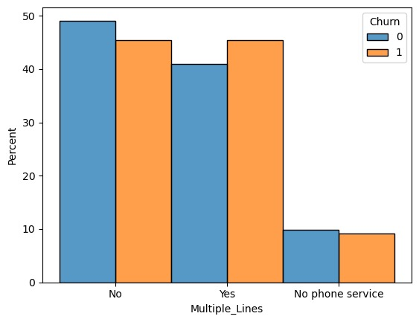
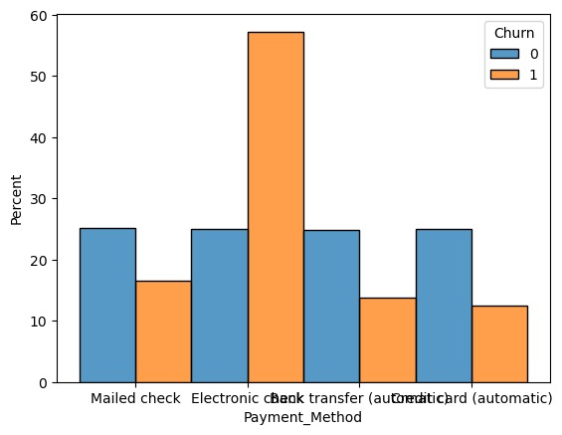
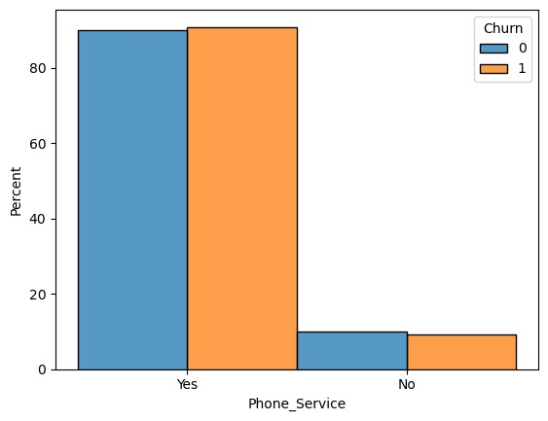
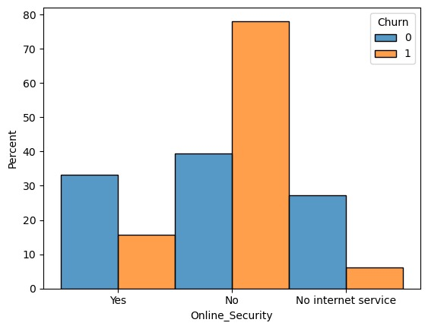
Category Wise Usage - 1

Slide 11
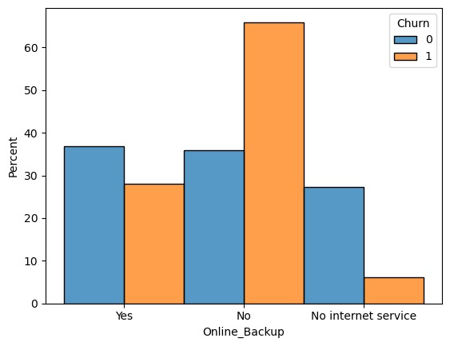
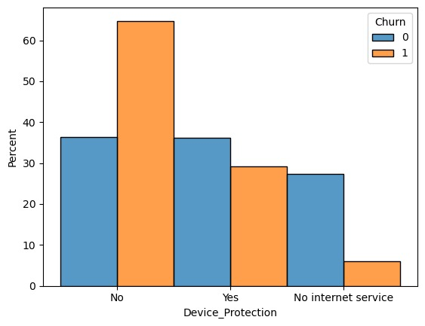
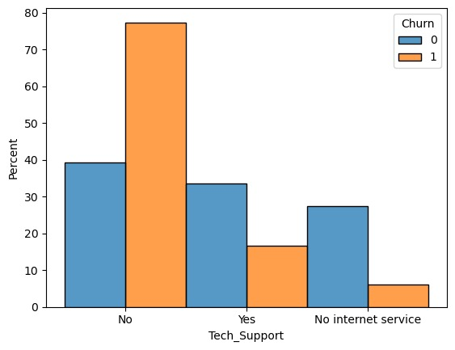
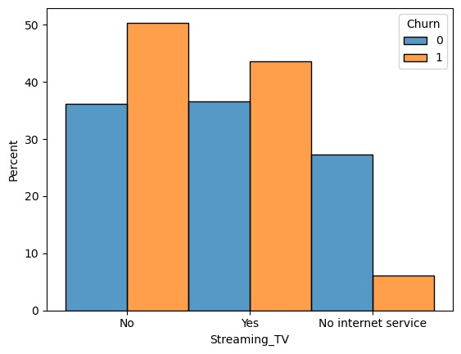
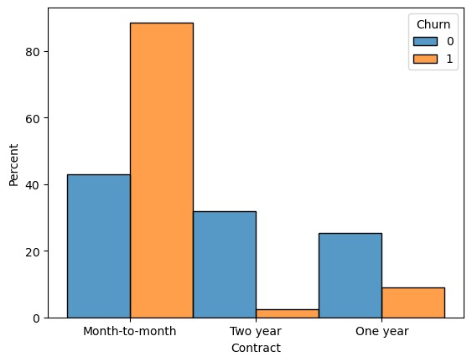
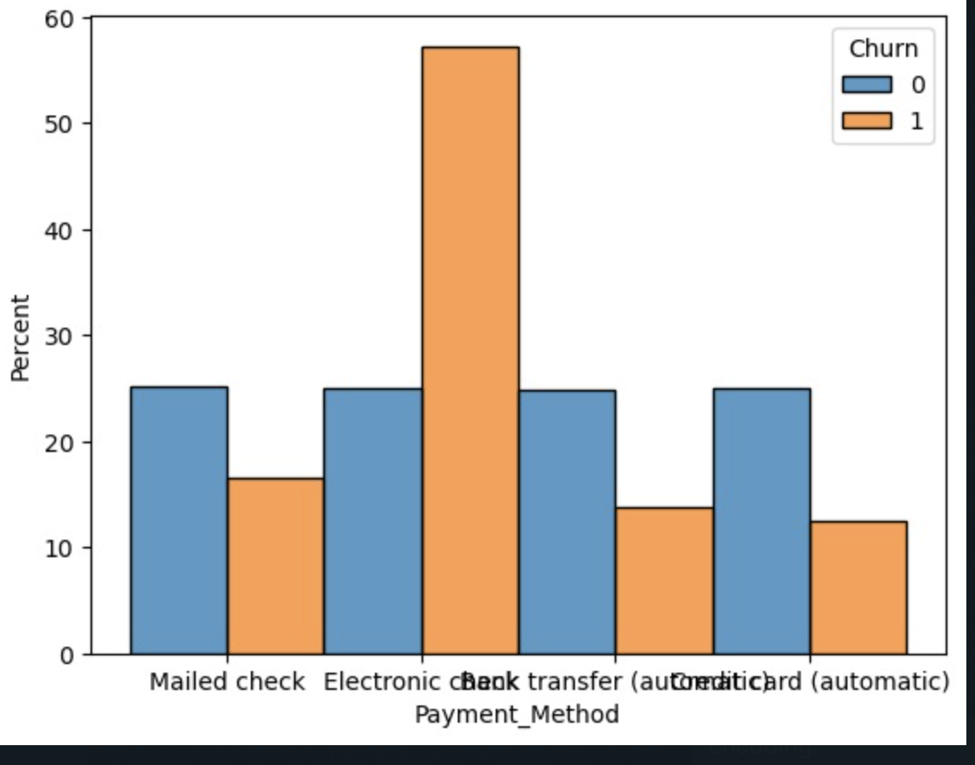
Category Wise Usage - 2

Slide 12
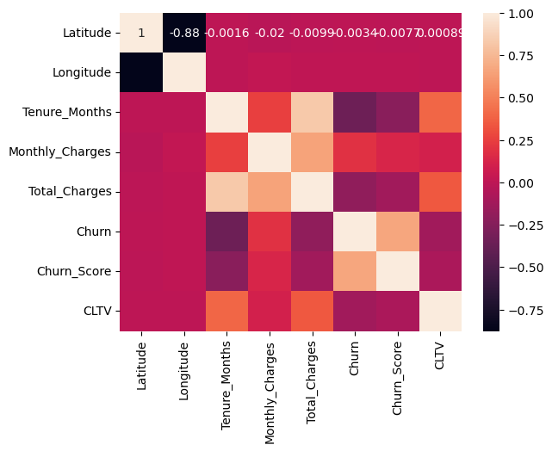
Heat Map

Slide 13
Model Building
Encoding:
Converting categorical variables into numerical representations for machine learning algorithms.
Splitting the Data Frame:
Dividing the dataset into 2 data frames independent features and dependent feature i.e., target variable to evaluate
Train test split:
Dividing the dataset into training and testing sets to evaluate model performance.
Scaling:
Standardizing numerical features to ensure uniformity and improve model convergence during training.

Slide 14
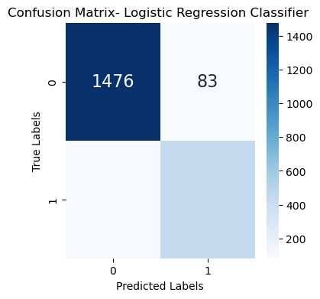
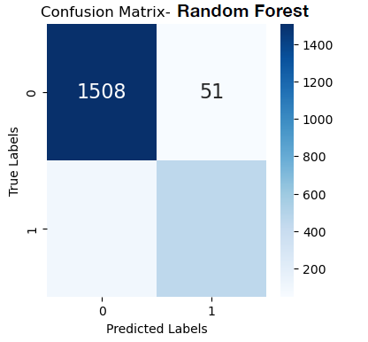
Logistic Regression classifier
Decision Tree
Random Forest
Accuracy: 0.9119734973970658
Accuracy: 0.9096071935636536
Accuracy: 0.96.712643634642688

Slide 15
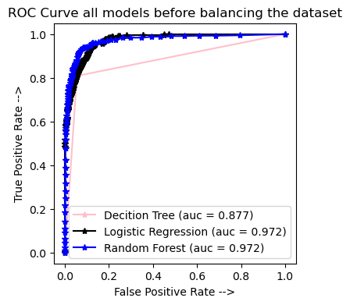
ROC Curve

Slide 16
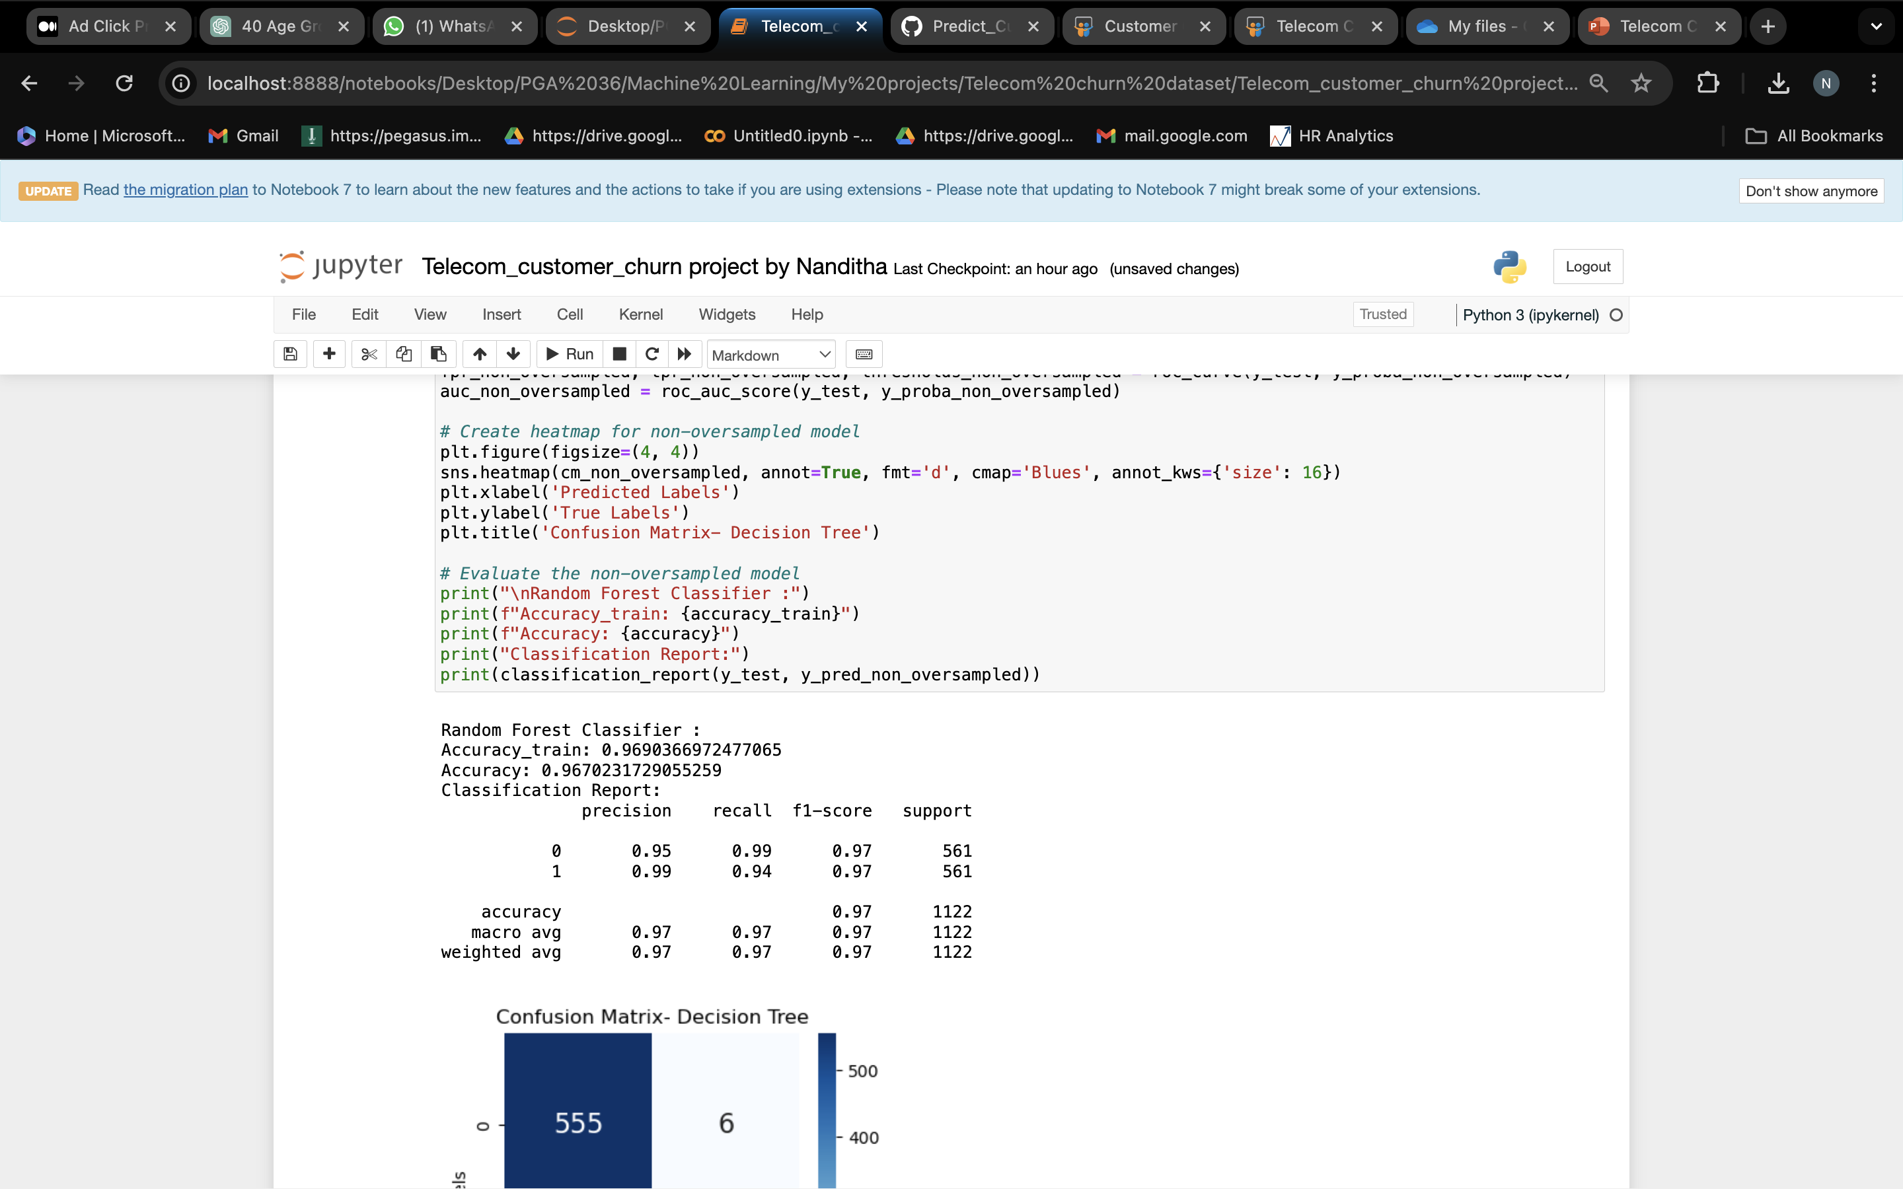
Summary
Random Forest model performs well compare to decision tree and logistic regression with accuracy 96.70 and classification report is below:​

Slide 17



Thank You

